Slide 1

Data Science ODL
Linear and Non-linear Models for Regression

Slide 2
Models for Regression
Abdulrahman Altahhan
Unit 4

Slide 3
Outline For the Series
Simple Linear Regression Models
Generalised Linear Regression Models with Basis
Generalised Multi-Output Non-linear Regression
Artificial Neural Networks

Slide 4
Simple Linear Regression Model
Linear Regression Models (LM)

Slide 5
Outline
What is Regression
Types of Regression
Univariate and multivariate
Linear and non-linear
Loss function
Optimising the loss
LR Learning Algorithms
Least Squares for LM
Batch Learning for LM
Sequential Learning for LM
Gradient Descent for LM
Stochastic Gradient Descent for LM

Slide 6
Regression Models
Schematic
(x)
Regression Model
(y)
Input
Attribute set
Output
Continuous Value

Slide 7

Regression Task
Training set
$\left(x_{n},t_{n}\right) n=1…N$
Input $x$ and actual (aka target) output $t$

Slide 8

Regression Task
Training set
$\left(x_{n},t_{n}\right) n=1…N$
Input $x$ and actual (aka target) output $t$
Our task in this unit
To Build a model $y\left(x,w\right)$ that captures the relationship between $x$ and $t$
$y$ is an estimator of target output $t$

Slide 9
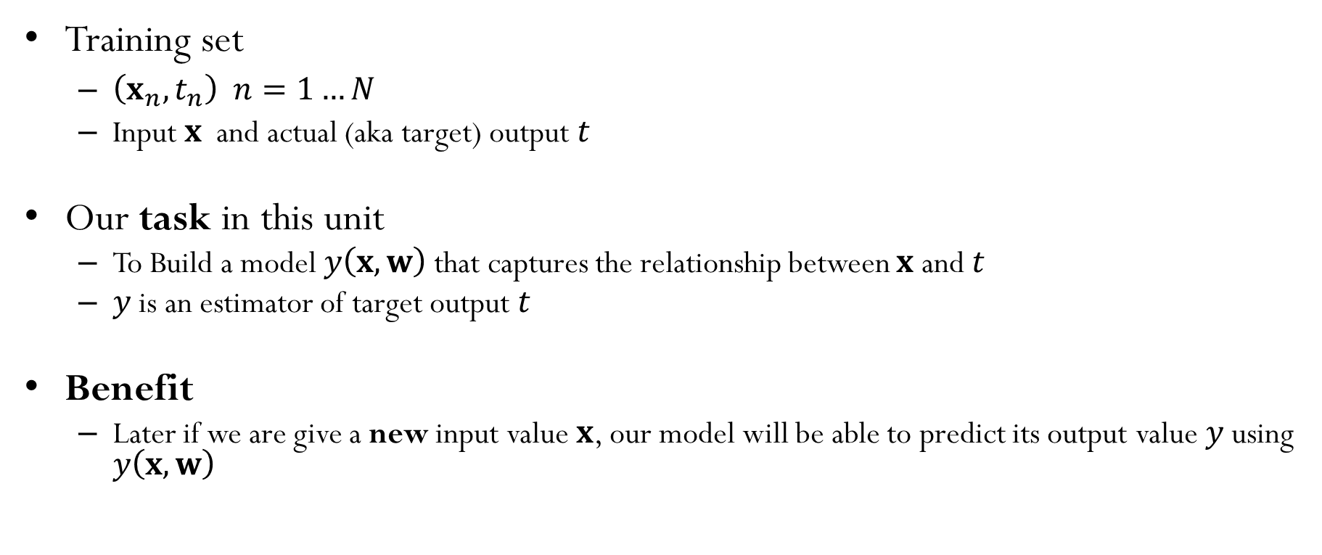
Regression Task
Training set
$\left(x_{n},t_{n}\right) n=1…N$
Input $x$ and actual (aka target) output $t$
Our task in this unit
To Build a model $y\left(x,w\right)$ that captures the relationship between $x$ and $t$
$y$ is an estimator of target output $t$
Benefit
Later if we are give a new input value $x$, our model will be able to predict its output value $y$ using $y\left(x,w\right)$

Slide 10

Regression: univariate vs multivariate
Training set is $\left(x_{n},t_{n}\right) n=1…N$
When we have one attribute, the input is called univariate
When we have multiple attributes, the input is called multi-variate

Slide 11


Datasets in univariate setting
$$x_{3}$$
$$t_{3}$$
x₁ | t
0.00632 | 24
0.02731 | 21.6
0.02729 | 34.7
0.03237 | 33.4
0.06905 | 36.2
0.02985 | 28.7
0.08829 | 22.9
0.14455 | 27.1
0.21124 | 16.5
0.17004 | 18.9
0.22489 | 15
0.11747 | 18.9
0.09378 | 21.7
0.62976 | 20.4
0.63796 | 18.2
0.62739 | 19.9
1.05393 | 23.1
0.7842 | 17.5
0.80271 | 20.2
0.7258 | 18.2
univariate data looks like this

Slide 12



Datasets in Multivariate setting
$$x_{3}$$
$$x_{3,5}$$
$$t_{3}$$
x₁ | x₂ | x₃ | x₄ | x₅ | x₆ | x₇ | x₈ | x₉ | x₁₀ | x₁₁ | x₁₂ | x₁₃ | t
0.00632 | 18 | 2.31 | 0 | 0.538 | 6.575 | 65.2 | 4.09 | 1 | 296 | 15.3 | 396.9 | 4.98 | 24
0.02731 | 0 | 7.07 | 0 | 0.469 | 6.421 | 78.9 | 4.9671 | 2 | 242 | 17.8 | 396.9 | 9.14 | 21.6
0.02729 | 0 | 7.07 | 0 | 0.469 | 7.185 | 61.1 | 4.9671 | 2 | 242 | 17.8 | 392.83 | 4.03 | 34.7
0.03237 | 0 | 2.18 | 0 | 0.458 | 6.998 | 45.8 | 6.0622 | 3 | 222 | 18.7 | 394.63 | 2.94 | 33.4
0.06905 | 0 | 2.18 | 0 | 0.458 | 7.147 | 54.2 | 6.0622 | 3 | 222 | 18.7 | 396.9 | 5.33 | 36.2
0.02985 | 0 | 2.18 | 0 | 0.458 | 6.43 | 58.7 | 6.0622 | 3 | 222 | 18.7 | 394.12 | 5.21 | 28.7
0.08829 | 12.5 | 7.87 | 0 | 0.524 | 6.012 | 66.6 | 5.5605 | 5 | 311 | 15.2 | 395.6 | 12.43 | 22.9
0.14455 | 12.5 | 7.87 | 0 | 0.524 | 6.172 | 96.1 | 5.9505 | 5 | 311 | 15.2 | 396.9 | 19.15 | 27.1
0.21124 | 12.5 | 7.87 | 0 | 0.524 | 5.631 | 100 | 6.0821 | 5 | 311 | 15.2 | 386.63 | 29.93 | 16.5
0.17004 | 12.5 | 7.87 | 0 | 0.524 | 6.004 | 85.9 | 6.5921 | 5 | 311 | 15.2 | 386.71 | 17.1 | 18.9
0.22489 | 12.5 | 7.87 | 0 | 0.524 | 6.377 | 94.3 | 6.3467 | 5 | 311 | 15.2 | 392.52 | 20.45 | 15
0.11747 | 12.5 | 7.87 | 0 | 0.524 | 6.009 | 82.9 | 6.2267 | 5 | 311 | 15.2 | 396.9 | 13.27 | 18.9
0.09378 | 12.5 | 7.87 | 0 | 0.524 | 5.889 | 39 | 5.4509 | 5 | 311 | 15.2 | 390.5 | 15.71 | 21.7
0.62976 | 0 | 8.14 | 0 | 0.538 | 5.949 | 61.8 | 4.7075 | 4 | 307 | 21 | 396.9 | 8.26 | 20.4
0.63796 | 0 | 8.14 | 0 | 0.538 | 6.096 | 84.5 | 4.4619 | 4 | 307 | 21 | 380.02 | 10.26 | 18.2
0.62739 | 0 | 8.14 | 0 | 0.538 | 5.834 | 56.5 | 4.4986 | 4 | 307 | 21 | 395.62 | 8.47 | 19.9
1.05393 | 0 | 8.14 | 0 | 0.538 | 5.935 | 29.3 | 4.4986 | 4 | 307 | 21 | 386.85 | 6.58 | 23.1
0.7842 | 0 | 8.14 | 0 | 0.538 | 5.99 | 81.7 | 4.2579 | 4 | 307 | 21 | 386.75 | 14.67 | 17.5
0.80271 | 0 | 8.14 | 0 | 0.538 | 5.456 | 36.6 | 3.7965 | 4 | 307 | 21 | 288.99 | 11.69 | 20.2
0.7258 | 0 | 8.14 | 0 | 0.538 | 5.727 | 69.5 | 3.7965 | 4 | 307 | 21 | 390.95 | 11.28 | 18.2
Multi-variate data looks like this

Slide 13

Regression: univariate vs multivariate
One input and one output: univariate
Each $x$ is one attribute value
$t$ is one reading
$y\left(x,w\right):ℝ⟶ℝ$

Slide 14

Regression: univariate vs multivariate
One input and one output: univariate
Each $x$ is one attribute value
$t$ is one reading
$y\left(x,w\right):ℝ⟶ℝ$
Multi-input and one-output: multivariate
Each $x$ is a set of attributes values
$t$ is one reading
$y\left(x,w\right):ℝ^{D}⟶ℝ$

Slide 15

Regression: univariate vs multivariate
One input and one output: univariate
Each $x$ is one attribute value
$t$ is one reading
$y\left(x,w\right):ℝ⟶ℝ$
Multi-input and one-output: multivariate
Each $x$ is a set of attributes values
$t$ is one reading
$y\left(x,w\right):ℝ^{D}⟶ℝ$
Multi-input and multi-output: multivariate multi-output
Each $x$ is a set of attributes values
and $t$ is a set of values
$y\left(x,w\right):ℝ^{D}⟶ℝ^{K}$

Slide 16

Regression: Linear vs non-linear
If the Relationship between input and output $y:x→ t$ is
Linear ➡ we are dealing with linear regression problem
Non-linear ➡ we are dealing with non-linear regression problem

Slide 17
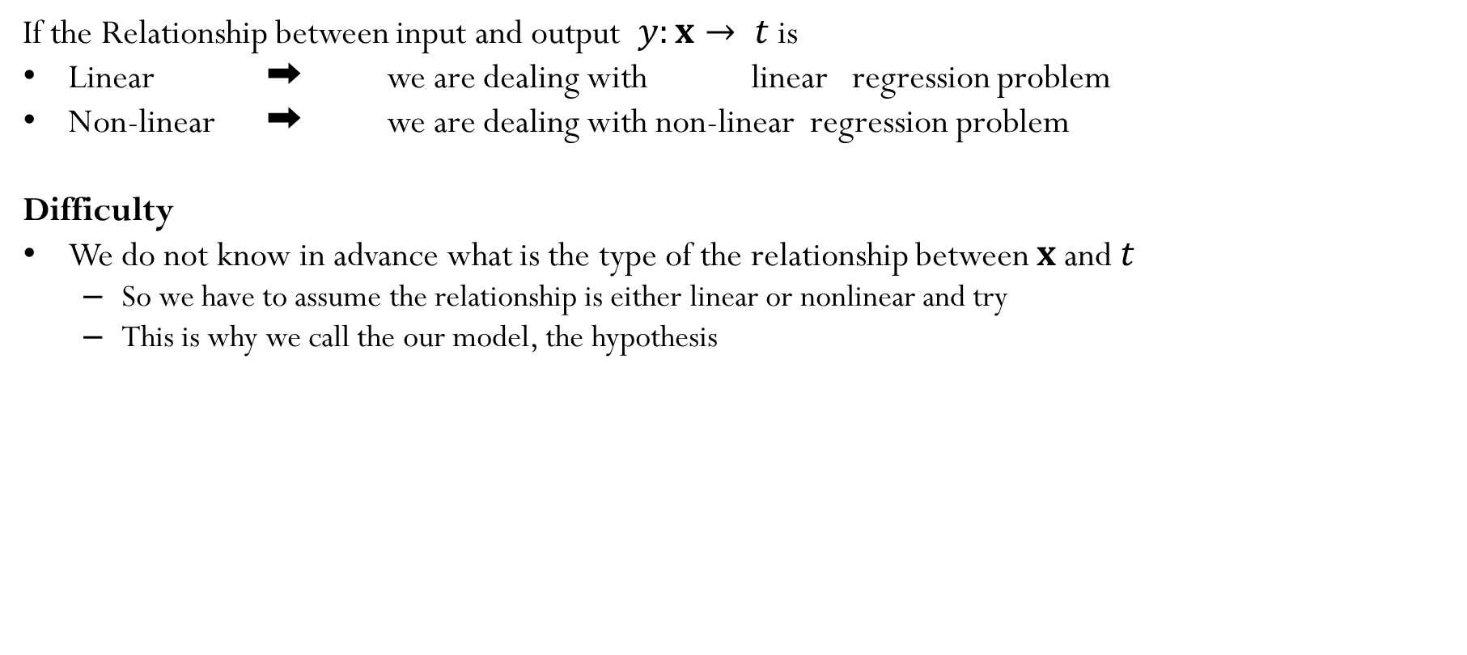
Regression: Linear vs non-linear
If the Relationship between input and output $y:x→ t$ is
Linear ➡ we are dealing with linear regression problem
Non-linear ➡ we are dealing with non-linear regression problem
Difficulty
We do not know in advance what is the type of the relationship between $x$ and $t$
So we have to assume the relationship is either linear or nonlinear and try
This is why we call the our model, the hypothesis

Slide 18
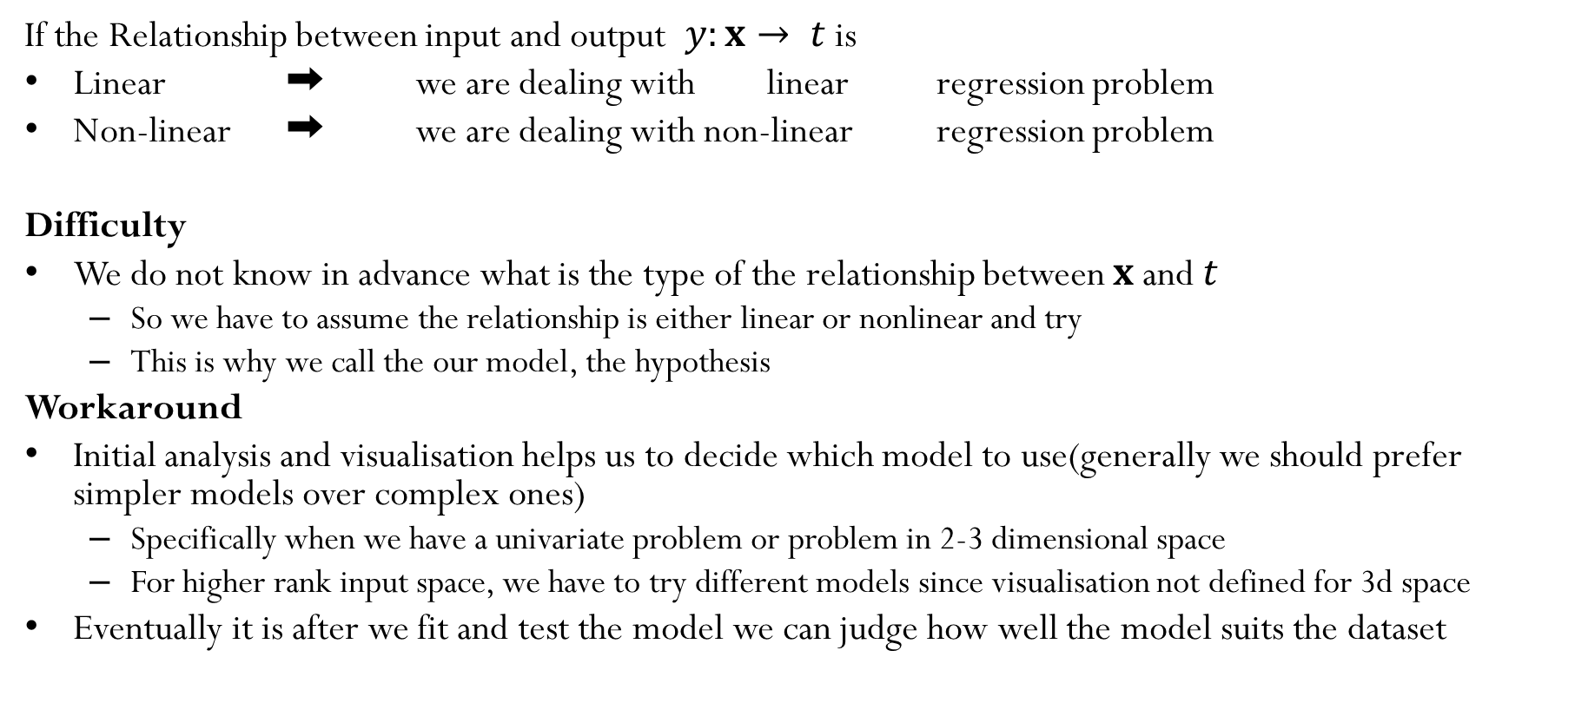
Regression: Linear vs non-linear
If the Relationship between input and output $y:x→ t$ is
Linear ➡ we are dealing with linear regression problem
Non-linear ➡ we are dealing with non-linear regression problem
Difficulty
We do not know in advance what is the type of the relationship between $x$ and $t$
So we have to assume the relationship is either linear or nonlinear and try
This is why we call the our model, the hypothesis
Workaround
Initial analysis and visualisation helps us to decide which model to use(generally we should prefer simpler models over complex ones)
Specifically when we have a univariate problem or problem in 2-3 dimensional space
For higher rank input space, we have to try different models since visualisation not defined for 3d space
Eventually it is after we fit and test the model we can judge how well the model suits the dataset

Slide 19
Loss Function for Regression

Slide 20




Dataset is univariate
$$x_{1}$$
$$t_{1}$$
$$y_{1}$$
 |  | X | t
n |  | x₁ | t
1 |  | 1 | 5.1
2 |  | 2.4 | 12.41
3 |  | 5.3 | 17.9
4 |  | 6.1 | 22.05
5 |  | 3.2 | 15.35
6 |  | 4.2 | 18.69
7 |  | 8.5 | 29.41
8 |  | 7.8 | 28.84
9 |  | 8.67 | 29.07
10 |  | 9.52 | 31.8
$$−$$
y
y
13
J̅ ²
J_{n}
-7.90
(J_{n})²
62.41
univariate data looks like this

Slide 21



Dataset is univariate
$$x_{2}$$
$$t_{2}$$
$$y_{2}$$
 |  | X | t
n |  | x₁ | t
1 |  | 1 | 5.1
2 |  | 2.4 | 12.41
3 |  | 5.3 | 17.9
4 |  | 6.1 | 22.05
5 |  | 3.2 | 15.35
6 |  | 4.2 | 18.69
7 |  | 8.5 | 29.41
8 |  | 7.8 | 28.84
9 |  | 8.67 | 29.07
10 |  | 9.52 | 31.8
$$−$$
y
y
13
17.2
J̅ ²
J_{n}
-7.90
-4.79
(J_{n})²
62.41
22.94
univariate data looks like this

Slide 22



Dataset is univariate
$$x_{3}$$
$$t_{3}$$
$$y_{3}$$
 |  | X | t
n |  | x₁ | t
1 |  | 1 | 5.1
2 |  | 2.4 | 12.41
3 |  | 5.3 | 17.9
4 |  | 6.1 | 22.05
5 |  | 3.2 | 15.35
6 |  | 4.2 | 18.69
7 |  | 8.5 | 29.41
8 |  | 7.8 | 28.84
9 |  | 8.67 | 29.07
10 |  | 9.52 | 31.8
$$−$$
y
y
13
17.2
25.9
J̅ ²
J_{n}
-7.90
-4.79
-8.00
(J_{n})²
62.41
22.94
64.00
univariate data looks like this

Slide 23



Dataset is univariate
$$x_{4}$$
$$t_{4}$$
$$y_{4}$$
 |  | X | t
n |  | x₁ | t
1 |  | 1 | 5.1
2 |  | 2.4 | 12.41
3 |  | 5.3 | 17.9
4 |  | 6.1 | 22.05
5 |  | 3.2 | 15.35
6 |  | 4.2 | 18.69
7 |  | 8.5 | 29.41
8 |  | 7.8 | 28.84
9 |  | 8.67 | 29.07
10 |  | 9.52 | 31.8
$$−$$
y
y
13
17.2
25.9
28.3
J̅ ²
J_{n}
-7.90
-4.79
-8.00
-6.25
(J_{n})²
62.41
22.94
64.00
39.06
univariate data looks like this

Slide 24



Dataset is univariate
$$x_{10}$$
$$t_{10}$$
$$y_{10}$$
 |  | X | t
n |  | x₁ | t
1 |  | 1 | 5.1
2 |  | 2.4 | 12.41
3 |  | 5.3 | 17.9
4 |  | 6.1 | 22.05
5 |  | 3.2 | 15.35
6 |  | 4.2 | 18.69
7 |  | 8.5 | 29.41
8 |  | 7.8 | 28.84
9 |  | 8.67 | 29.07
10 |  | 9.52 | 31.8
$$−$$
y
y
13
17.2
25.9
28.3
19.6
22.6
35.5
33.4
36.01
38.56
J̅ ²
J_{n}
-7.90
-4.79
-8.00
-6.25
-4.25
-3.91
-6.09
-4.56
-6.94
-6.76
(J_{n})²
62.41
22.94
64.00
39.06
18.06
15.29
37.09
20.79
48.16
45.70
Loss 18.67
univariate data looks like this

Slide 25



Dataset is univariate
$$x_{9}$$
$$t_{9}$$
$$y_{9}$$
 |  | X | t
n |  | x₁ | t
1 |  | 1 | 5.1
2 |  | 2.4 | 12.41
3 |  | 5.3 | 17.9
4 |  | 6.1 | 22.05
5 |  | 3.2 | 15.35
6 |  | 4.2 | 18.69
7 |  | 8.5 | 29.41
8 |  | 7.8 | 28.84
9 |  | 8.67 | 29.07
10 |  | 9.52 | 31.8
y
y
13
17.2
25.9
28.3
19.6
22.6
35.5
33.4
36.01
38.56
J̅ ²
J_{n}
-7.90
-4.79
-8.00
-6.25
-4.25
-3.91
-6.09
-4.56
-6.94
-6.76
(J_{n})²
62.41
22.94
64.00
39.06
18.06
15.29
37.09
20.79
48.16
45.70
Loss 18.67
univariate data looks like this

Slide 26

Regression Loss Value
Regression Loss is the Mean of Squares Errors(MSE), written as
$$\overline{J^{2}}=\frac{1}{2N}\sum_{n=1}^{N}{{\left(t_{n}−y_{n}\right)}^{2}}$$
N = how many data points we have

Slide 27

Regression Loss Value
Regression Loss is the Mean of Squares Errors(MSE), written as
$$\overline{J^{2}}=\frac{1}{2N}\sum_{n=1}^{N}{{\left(t_{n}−y_{n}\right)}^{2}}$$
N = how many data points we have
$t_{n}$ = actual output for input $x_{n}$
$y_{n}=$ estimated output for input $x_{n}$ (aka hypothesis)

Slide 28
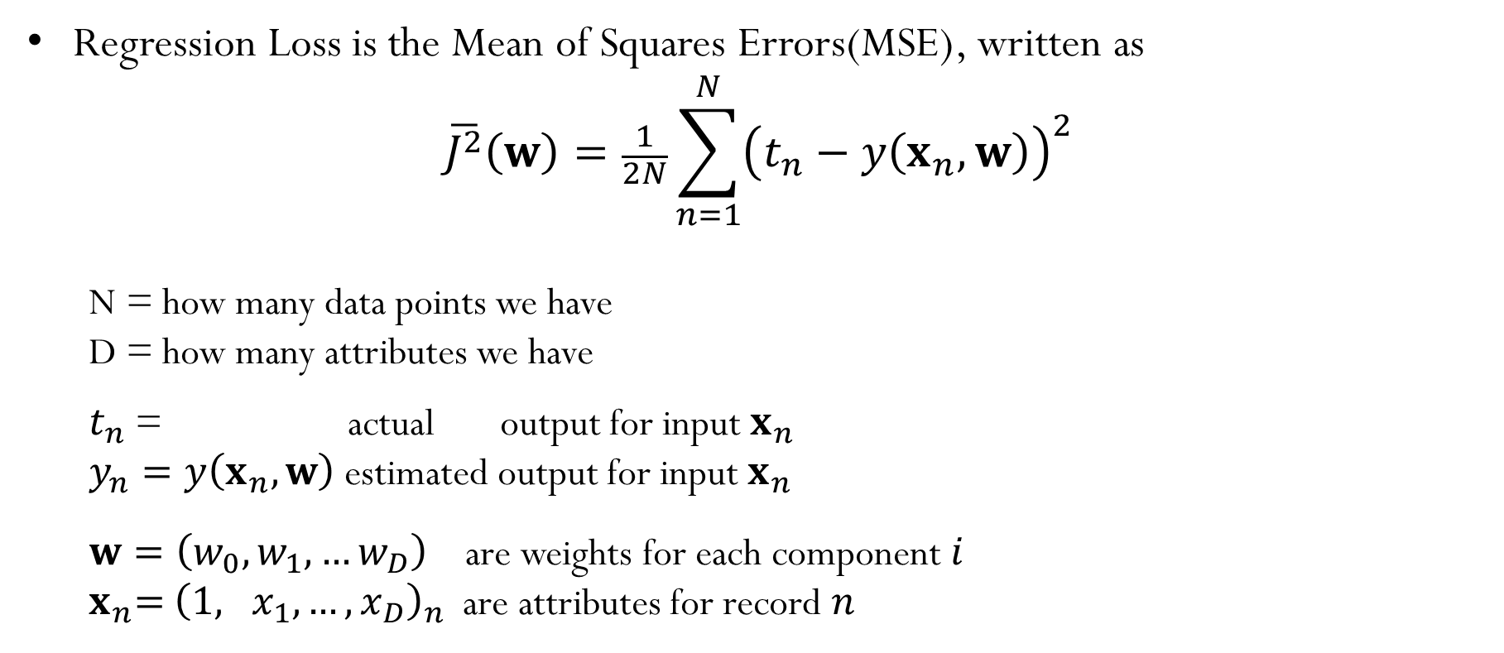
Regression Loss Function
Regression Loss is the Mean of Squares Errors(MSE), written as
$$\overline{J^{2}}\left(w\right)=\frac{1}{2N}\sum_{n=1}^{N}{{\left(t_{n}−y\left(x_{n},w\right)\right)}^{2}}$$
N = how many data points we have
D = how many attributes we have
$t_{n}$ = actual output for input $x_{n}$
$y_{n}=y\left(x_{n},w\right)$ estimated output for input $x_{n}$
$w=\left(w_{0},w_{1},…w_{D}\right)$ are weights for each component $i$
$x_{n}\text{= }{\left(1, x_{1}, …,x_{D}\right)}_{n}$ are attributes for record $n$

Slide 29
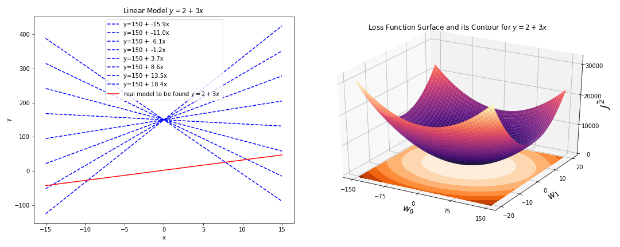
Regression Loss Function
Regression Loss is the Mean of Squares Errors(MSE), written as
$$\overline{J^{2}}\left(w\right)=\frac{1}{2N}\sum_{n=1}^{N}{{\left(t_{n}−y\left(x_{n},w\right)\right)}^{2}}$$
N = how many data points we have
D = how many attributes we have
$t_{n}$ = actual output for input $x_{n}$
$y_{n}=y\left(x_{n},w\right)$ estimated output for input $x_{n}$
$w=\left(w_{0},w_{1},…w_{D}\right)$ are weights for each component $i$
$x_{n}\text{= }{\left(1, x_{1}, …,x_{D}\right)}_{n}$ are attributes for record $n$

Slide 30
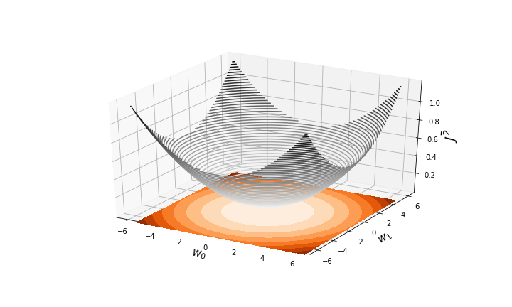

Regression Loss Function
Regression Loss is the Mean of Squares Errors(MSE), written as
$$\overline{J^{2}}\left(w\right)=\frac{1}{2N}\sum_{n=1}^{N}{{\left(t_{n}−y\left(x_{n},w\right)\right)}^{2}}$$
Main Questions of this unit:
How to optimise the loss by choosing best $w$?
x

Slide 31


Regression Loss Function
Regression Loss is the Mean of Squares Errors(MSE), written as
$$\overline{J^{2}}\left(w\right)=\frac{1}{2N}\sum_{n=1}^{N}{{\left(t_{n}−y\left(x_{n},w\right)\right)}^{2}}$$
Main Questions of this unit:
How to optimise the loss by choosing best $w$?
How to gradually change $w$ to reduce the loss?
x
x

Slide 32
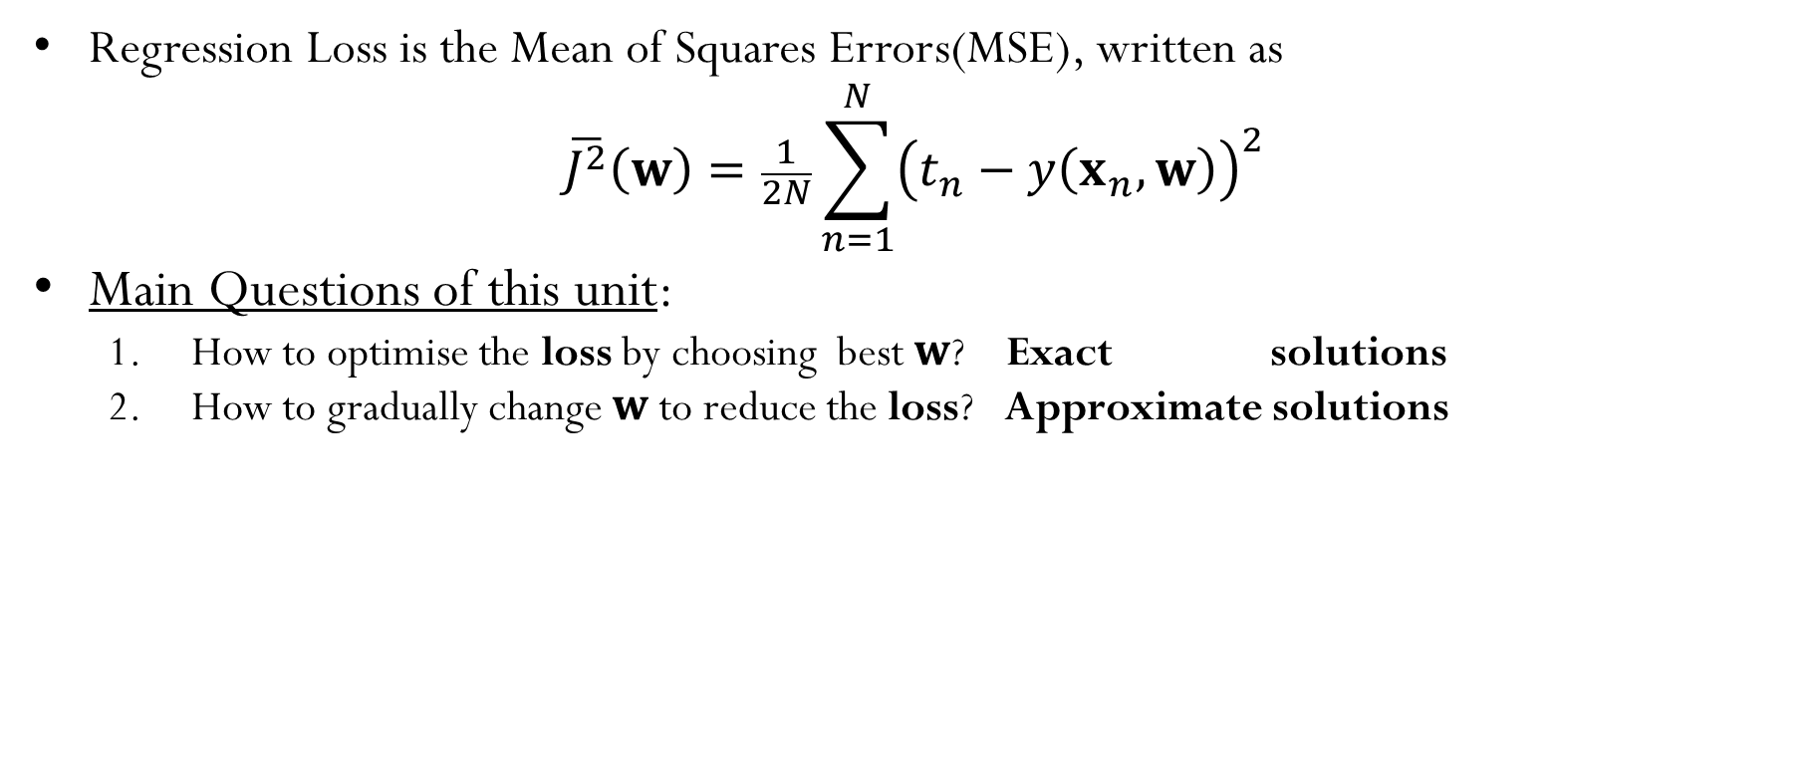
Regression Loss Function
Regression Loss is the Mean of Squares Errors(MSE), written as
$$\overline{J^{2}}\left(w\right)=\frac{1}{2N}\sum_{n=1}^{N}{{\left(t_{n}−y\left(x_{n},w\right)\right)}^{2}}$$
Main Questions of this unit:
How to optimise the loss by choosing best $w$? Exact solutions
How to gradually change $w$ to reduce the loss? Approximate solutions
x
x

Slide 33
Linear Regression Models
Least Squares

Slide 34

Datasets in Univariate Setting
$$x_{3}$$
$$t_{3}$$
x | t
0.00632 | 24
0.02731 | 21.6
0.02729 | 34.7
0.03237 | 33.4
0.06905 | 36.2
0.02985 | 28.7
0.08829 | 22.9
0.14455 | 27.1
0.21124 | 16.5
0.17004 | 18.9
0.22489 | 15
0.11747 | 18.9
0.09378 | 21.7
0.62976 | 20.4
0.63796 | 18.2
0.62739 | 19.9
1.05393 | 23.1
0.7842 | 17.5
0.80271 | 20.2
0.7258 | 18.2

Slide 35
Datasets in Multivariate Setting
$$x_{3}$$
$$x_{3,5}$$
$$t_{3}$$
x₁ | x₂ | x₃ | x₄ | x₅ | x₆ | x₇ | x₈ | x₉ | x₁₀ | x₁₁ | x₁₂ | x₁₃ | t
0.00632 | 18 | 2.31 | 0 | 0.538 | 6.575 | 65.2 | 4.09 | 1 | 296 | 15.3 | 396.9 | 4.98 | 24
0.02731 | 0 | 7.07 | 0 | 0.469 | 6.421 | 78.9 | 4.9671 | 2 | 242 | 17.8 | 396.9 | 9.14 | 21.6
0.02729 | 0 | 7.07 | 0 | 0.469 | 7.185 | 61.1 | 4.9671 | 2 | 242 | 17.8 | 392.83 | 4.03 | 34.7
0.03237 | 0 | 2.18 | 0 | 0.458 | 6.998 | 45.8 | 6.0622 | 3 | 222 | 18.7 | 394.63 | 2.94 | 33.4
0.06905 | 0 | 2.18 | 0 | 0.458 | 7.147 | 54.2 | 6.0622 | 3 | 222 | 18.7 | 396.9 | 5.33 | 36.2
0.02985 | 0 | 2.18 | 0 | 0.458 | 6.43 | 58.7 | 6.0622 | 3 | 222 | 18.7 | 394.12 | 5.21 | 28.7
0.08829 | 12.5 | 7.87 | 0 | 0.524 | 6.012 | 66.6 | 5.5605 | 5 | 311 | 15.2 | 395.6 | 12.43 | 22.9
0.14455 | 12.5 | 7.87 | 0 | 0.524 | 6.172 | 96.1 | 5.9505 | 5 | 311 | 15.2 | 396.9 | 19.15 | 27.1
0.21124 | 12.5 | 7.87 | 0 | 0.524 | 5.631 | 100 | 6.0821 | 5 | 311 | 15.2 | 386.63 | 29.93 | 16.5
0.17004 | 12.5 | 7.87 | 0 | 0.524 | 6.004 | 85.9 | 6.5921 | 5 | 311 | 15.2 | 386.71 | 17.1 | 18.9
0.22489 | 12.5 | 7.87 | 0 | 0.524 | 6.377 | 94.3 | 6.3467 | 5 | 311 | 15.2 | 392.52 | 20.45 | 15
0.11747 | 12.5 | 7.87 | 0 | 0.524 | 6.009 | 82.9 | 6.2267 | 5 | 311 | 15.2 | 396.9 | 13.27 | 18.9
0.09378 | 12.5 | 7.87 | 0 | 0.524 | 5.889 | 39 | 5.4509 | 5 | 311 | 15.2 | 390.5 | 15.71 | 21.7
0.62976 | 0 | 8.14 | 0 | 0.538 | 5.949 | 61.8 | 4.7075 | 4 | 307 | 21 | 396.9 | 8.26 | 20.4
0.63796 | 0 | 8.14 | 0 | 0.538 | 6.096 | 84.5 | 4.4619 | 4 | 307 | 21 | 380.02 | 10.26 | 18.2
0.62739 | 0 | 8.14 | 0 | 0.538 | 5.834 | 56.5 | 4.4986 | 4 | 307 | 21 | 395.62 | 8.47 | 19.9
1.05393 | 0 | 8.14 | 0 | 0.538 | 5.935 | 29.3 | 4.4986 | 4 | 307 | 21 | 386.85 | 6.58 | 23.1
0.7842 | 0 | 8.14 | 0 | 0.538 | 5.99 | 81.7 | 4.2579 | 4 | 307 | 21 | 386.75 | 14.67 | 17.5
0.80271 | 0 | 8.14 | 0 | 0.538 | 5.456 | 36.6 | 3.7965 | 4 | 307 | 21 | 288.99 | 11.69 | 20.2
0.7258 | 0 | 8.14 | 0 | 0.538 | 5.727 | 69.5 | 3.7965 | 4 | 307 | 21 | 390.95 | 11.28 | 18.2

Slide 36

Linear Models
Univariate
$$y\left(x,w\right)=w_{0}+w_{1}x_{1}$$
$$y\left(x,w\right)=70+0.2x_{1}$$
Multivariate
$$y\left(x,w\right)=w_{0}+w_{1}x_{1}+…+w_{D}x_{D}$$
$$y\left(x,w\right)=70+0.2x_{1}+4x_{2}−6x_{3}$$

Slide 37

Linear Models
Multivariate (univariate is a special case)
$$y\left(x,w\right)=w_{0}\underset{1}{\underbrace{x_{0}}}+w_{1}x_{1}+…+w_{D}x_{D}$$
$$y\left(x,w\right)=70x_{0}+0.2x_{1}+4x_{2}−6x_{3}$$
$$y\left(x,w\right)=\sum_{i=0}^{D}{w_{i}x_{i}}$$
$$=w^{⊤}x$$

Slide 38

Linear Models: vectorisation
Now we can express the model in a vector form
$$y\left(x,w\right)=\sum_{i=0}^{D}{w_{i}x_{i}}$$
$$=w^{⊤}x$$
$w^{⊤}=\left[\begin{matrix}w_{0} & w_{1} & … & w_{D}\end{matrix}\right]$ $x=\left[\begin{aligned}\begin{matrix}x_{0} \\ x_{1} \\ \end{matrix} \\ ⋮ \\ x_{D}\end{aligned}\right]$
This is not just fancy math, it is important for implementation!
Why?

Slide 39
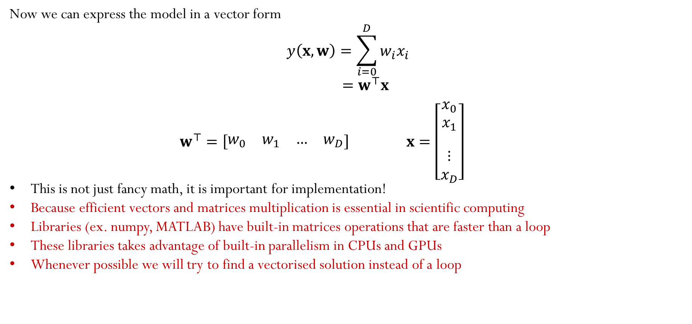
Linear Models: vectorisation
Now we can express the model in a vector form
$$y\left(x,w\right)=\sum_{i=0}^{D}{w_{i}x_{i}}$$
$$=w^{⊤}x$$
$w^{⊤}=\left[\begin{matrix}w_{0} & w_{1} & … & w_{D}\end{matrix}\right]$ $x=\left[\begin{aligned}\begin{matrix}x_{0} \\ x_{1} \\ \end{matrix} \\ ⋮ \\ x_{D}\end{aligned}\right]$
This is not just fancy math, it is important for implementation!
Because efficient vectors and matrices multiplication is essential in scientific computing
Libraries (ex. numpy, MATLAB) have built-in matrices operations that are faster than a loop
These libraries takes advantage of built-in parallelism in CPUs and GPUs
Whenever possible we will try to find a vectorised solution instead of a loop

Slide 40
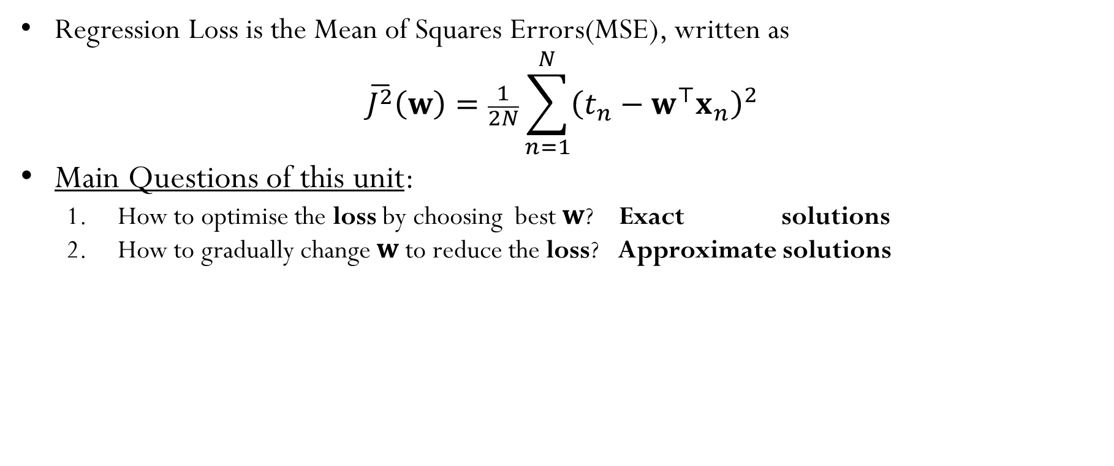
Linear Regression Loss
Regression Loss is the Mean of Squares Errors(MSE), written as
$$\overline{J^{2}}\left(w\right)=\frac{1}{2N}\sum_{n=1}^{N}{{\left(t_{n}−w^{⊤}x_{n}\right)}^{2}}$$
Main Questions of this unit:
How to optimise the loss by choosing best $w$? Exact solutions
How to gradually change $w$ to reduce the loss? Approximate solutions
x
x

Slide 41

Linear Regression Loss: vectorisation
$$\overline{J^{2}}=\frac{1}{2N}\sum_{n=1}^{N}{{\left(t_{n}−x_{n}^{⊤}w\right)}^{2}}$$
$\overset{t}{\overbrace{\left[\begin{aligned}\begin{matrix}t_{1} \\ ⋮ \\ t_{n}\end{matrix} \\ ⋮ \\ t_{N}\end{aligned}\right]}} − \overset{X}{\overbrace{\left[\begin{aligned}\begin{matrix}1 & x_{1,1} & \begin{matrix}… & x_{1,D}\end{matrix} \\ ⋮ & ⋮ & \begin{matrix}⋱ & ⋮ \end{matrix} \\ 1 & x_{n,1} & \begin{matrix}⋯ & x_{n,D}\end{matrix}\end{matrix} \\ \begin{matrix}⋮ & ⋮ & \begin{matrix}⋱ & ⋮ \end{matrix}\end{matrix} \\ \begin{matrix}1 & x_{N,1} & \begin{matrix}⋯ & x_{N,D}\end{matrix}\end{matrix}\end{aligned}\right]}}\overset{w}{\overbrace{\left[\begin{aligned}w_{0} \\ w_{1} \\ ⋮ \\ w_{D}\end{aligned}\right]}}$
$$\overline{J^{2}}=\frac{1}{2N}{ \left\|t−Xw\right\|}^{2}$$

Slide 42

Least Squares for Linear Regression
$$\overline{J^{2}}=\frac{1}{2N}{\left\|t−Xw\right\|}^{2}$$
To minimise: take the gradient and set it to 0
$$∇\overline{J^{2}}=−\frac{2}{2N}X^{⊤}\left(t−Xw\right)=0$$
$$X^{⊤}Xw^{∗}=X^{⊤}t$$
Solve for optimal weights $w^{∗}$
$$w^{∗}={\left(X^{⊤}X\right)}^{−1}X^{⊤}t$$

Slide 43

Least Squares for Linear Regression
Algorithms 1: Least Squares for Linear Regression‎
Input:
Input set: design matrix $X={\left[x_{1}^{⊤},…,x_{N}^{⊤}\right]}^{⊤}$
Labels set: vector $t={\left[t_{1},…,t_{N}\right]}^{⊤}$
Output: $w^{∗}$ optimum weights
LS_LRegress($X,t$):
$X=[1_{N},X]$
${w^{∗}=\left(X^{⊤}X\right)}^{−1}\left(X^{⊤}t\right)$
Return $w^{∗}$
LS
x

Slide 44










Linear Regression Models
$$x$$
1
$$w_{0}$$
$$x_{1}$$
$$w_{1}$$
$$y\text{=}w^{⊤}x$$
$$y\left(x,w\right)$$
$$⋮$$
$$⋮$$
$$w_{D}$$
Gradient Descent
$$x_{D}$$

Slide 45


Gradient Decent for LR
Gradient of Loss
Gradient Decent
$$\overline{J^{2}}=\frac{1}{2N}\sum_{n=1}^{N}{{\left(t_{n}−w^{⊤}x_{n}\right)}^{2}}$$
$$∇\overline{J^{2}}\left(w\right)=\frac{1}{2N}\sum_{n=1}^{N}{{−2x}_{n}\left(t_{n}−w^{⊤}x_{n}\right)}$$
$$w=w−η∇\overline{J^{2}}\left(w\right)$$
$$w=w+\frac{η}{N}\sum_{n=1}^{N}{x_{n}\left(t_{n}−w^{⊤}x_{n}\right)}$$
GD
x
x
x
x
x
x
x
LS

Slide 46


Gradient Decent for LR: vectorised
Gradient of Loss
Gradient Decent
$$\overline{J^{2}}=\frac{1}{2N}{\left\|t−Xw\right\|}^{2}$$
$$∇\overline{J^{2}}\left(w\right)=\frac{η}{N}X^{⊤}\left(t−Xw\right)$$
$$w=w−η∇\overline{J^{2}}\left(w\right)$$
$$w=w+\frac{η}{N}X^{⊤}\left(t−Xw\right)$$
GD
x
x
x
x
x
x
x
LS

Slide 47

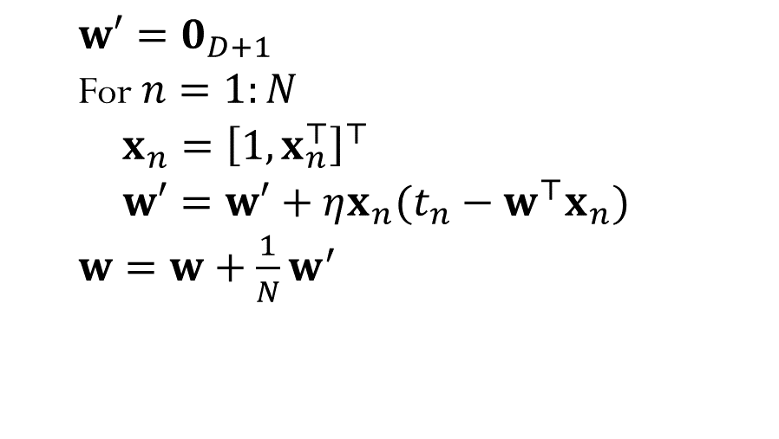
Gradient Decent update for LR
GD for LR: Loop
GD for LR: Vectorised
$w′=0_{D+1}$
For $n=1:N$
$x_{n}={\left[1,x_{n}^{⊤}\right]}^{⊤}$
$w′=w′+ηx_{n}(t_{n}−w^{⊤}x_{n})$
$w=w+\frac{1}{N}w^{′}$
$X=\left[1_{N},X\right]$
$w=w+η\frac{1}{N}X^{⊤}\left(t−Xw\right)$

Slide 48
Linear Regression Models
$$x$$
1
$$w_{0}$$
$$x_{1}$$
$$w_{1}$$
$$y\text{=}w^{⊤}x$$
$$y\left(x,w\right)$$
$$⋮$$
$$⋮$$
$$w_{D}$$
Stochastic Gradient Descent
$$x_{D}$$

Slide 49


Stochastic Gradient Descent for LR
Gradient of Individual Loss
Stochastic Gradient Decent
$$J_{n}^{2}={\left(t_{n}−w^{⊤}x_{n}\right)}^{2}$$
$$∇\overline{J_{n}^{2}}\left(w\right)=−x_{n}\left(t_{n}−w^{⊤}x_{n}\right)$$
$$w=w−η∇J_{n}^{2}\left(w\right)$$
$$w=w+ηx_{n}\left(t_{n}−w^{⊤}x_{n}\right)$$
x
SGD
x
x
x
x
x
x
x
x
x
x
LS

Slide 50
Stochastic Gradient Descent for LR: vectorised?
Gradient of Individual Loss
Stochastic Gradient Decent
$$J_{n}^{2}={\left(t_{n}−w^{⊤}x_{n}\right)}^{2}$$
$$∇\overline{J_{n}^{2}}\left(w\right)=−x_{n}\left(t_{n}−w^{⊤}x_{n}\right)$$
$$w=w−η∇J_{n}^{2}\left(w\right)$$
$$w=w+ηx_{n}\left(t_{n}−w^{⊤}x_{n}\right)$$
We cannot vectorise here?
x
SGD
x
x
x
Because we are dealing with individual data points
x
x
x
x
x
x
x
So there is no group of points that we can unify their updates in one go
LS

Slide 51
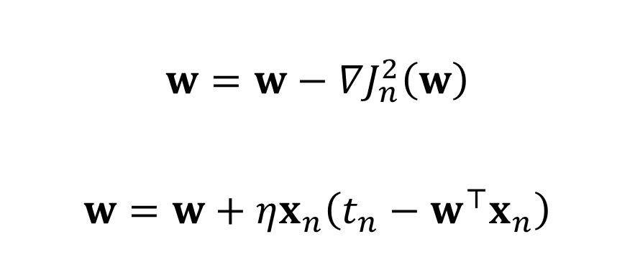

Batch vs Stochastic Gradient Decent
Batch Gradient Descent
Stochastic Gradient Descent
$$w=w−∇\overline{J^{2}}\left(w\right)$$
$$w=w+\frac{η}{N}X^{⊤}\left(t−Xw\right)$$
$$w=w−∇J_{n}^{2}\left(w\right)$$
$$w=w+ηx_{n}\left(t_{n}−w^{⊤}x_{n}\right)$$
GD
x
SGD
x
x
x
x
x
x
x
x
x
x
x
x
x
x
x
x
x
x
x
LS

Slide 52
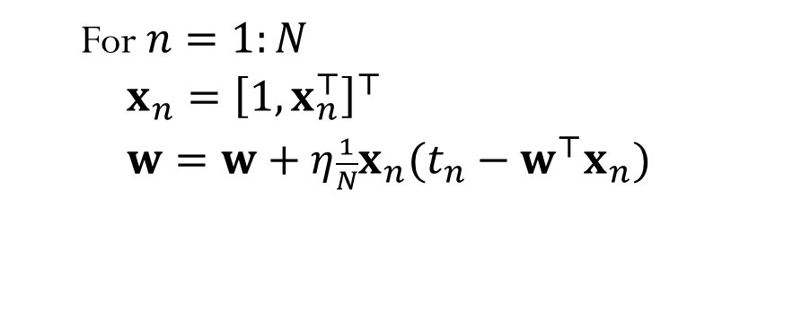
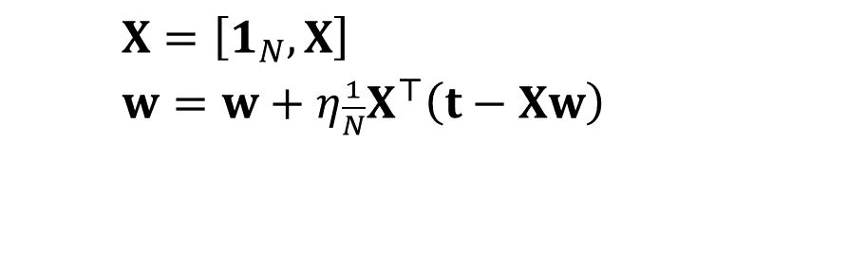
Gradient vs Stochastic Gradient Updates for LR
Batch Gradient Descent on LR
Stochastic Gradient Decent on LR
$X=\left[1_{N},X\right]$
$w=w+η\frac{1}{N}X^{⊤}\left(t−Xw\right)$
For $n=1:N$
$x_{n}={\left[1,x_{n}^{⊤}\right]}^{⊤}$
$w=w+η\frac{1}{N}x_{n}(t_{n}−w^{⊤}x_{n})$

Slide 53
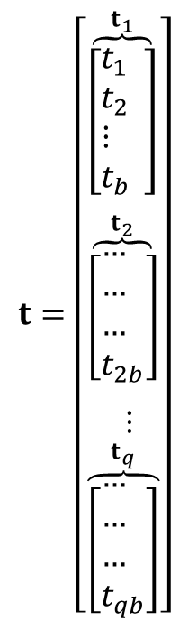
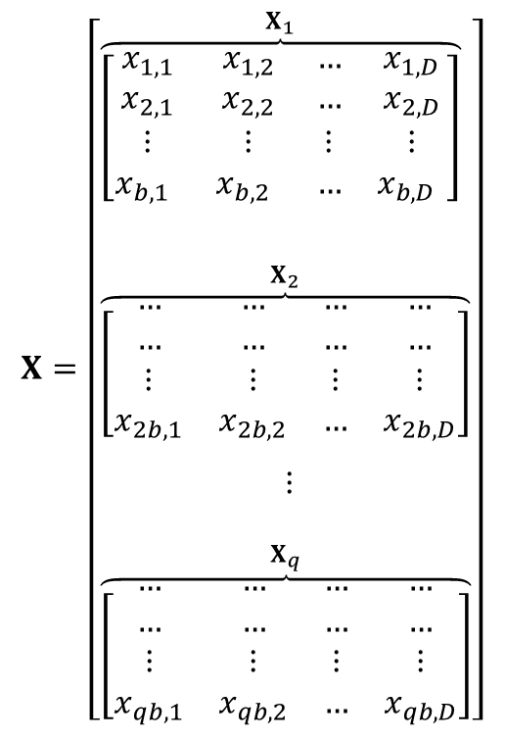
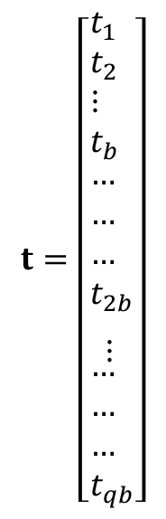
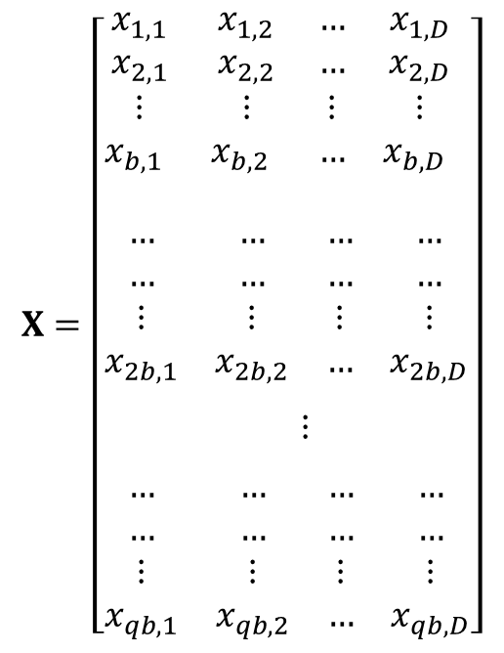
Batch vs. Mini-Batch Learning
Batch Learning
Mini-Batch Learning
$$X=\left[\begin{aligned}&\overset{X_{1}}{\overbrace{\left[\begin{matrix}x_{1,1} & x_{1,2} & … & x_{1,D} \\ x_{2,1} & x_{2,2} & … & x_{2,D} \\ ⋮ & ⋮ & ⋮ & ⋮ \\ x_{b,1 } & x_{b,2 } & … & x_{b,D }\end{matrix}\right]}} \\ & \\ & \\ &\overset{X_{2}}{\overbrace{\left[\begin{matrix}… & … & … & … \\ … & … & … & … \\ ⋮ & ⋮ & ⋮ & ⋮ \\ x_{2b,1} & x_{2b,2} & … & x_{2b,D}\end{matrix}\right]}} \\ & \\ & ⋮ \\ & \\ &\overset{X_{q}}{\overbrace{\left[\begin{matrix}… & … & … & … \\ … & … & … & … \\ ⋮ & ⋮ & ⋮ & ⋮ \\ x_{qb,1} & x_{qb,2} & … & x_{qb,D}\end{matrix}\right]}}\end{aligned}\right]$$
$$t=\left[\begin{aligned}&\overset{t_{1}}{\overbrace{\left[\begin{aligned}&t_{1 } \\ &t_{2} \\ &⋮ \\ &t_{b } \end{aligned}\right]}} \\ & \\ &\overset{t_{2}}{\overbrace{\left[\begin{aligned}&… \\ &… \\ &… \\ &t_{2b}\end{aligned}\right]}} \\ & \\ & ⋮ \\ &\overset{t_{q}}{\overbrace{\left[\begin{aligned}&… \\ &… \\ &… \\ &t_{qb}\end{aligned}\right]}}\end{aligned}\right]$$
$$X=\left[\begin{aligned}&\begin{matrix}x_{1,1} & x_{1,2} & … & x_{1,D} \\ x_{2,1} & x_{2,2} & … & x_{2,D} \\ ⋮ & ⋮ & ⋮ & ⋮ \\ x_{b,1 } & x_{b,2 } & … & x_{b,D }\end{matrix} \\ & \\ & \\ &\begin{matrix}… & … & … & … \\ … & … & … & … \\ ⋮ & ⋮ & ⋮ & ⋮ \\ x_{2b,1} & x_{2b,2} & … & x_{2b,D}\end{matrix} \\ & \\ & ⋮ \\ & \\ &\begin{matrix}… & … & … & … \\ … & … & … & … \\ ⋮ & ⋮ & ⋮ & ⋮ \\ x_{qb,1} & x_{qb,2} & … & x_{qb,D}\end{matrix}\end{aligned}\right]$$
$$t=\left[\begin{aligned}&\begin{aligned}&t_{1 } \\ &t_{2} \\ &⋮ \\ &t_{b } \end{aligned} \\ & \\ &\begin{aligned}&… \\ &… \\ &… \\ &t_{2b}\end{aligned} \\ & \\ & ⋮ \\ &\begin{aligned}&… \\ &… \\ &… \\ &t_{qb}\end{aligned}\end{aligned}\right]$$

Slide 54
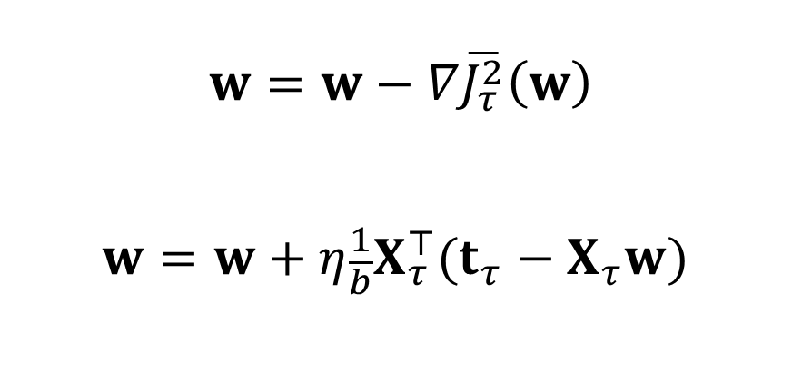

Batch vs Mini-Batch Gradient Decent
Batch Gradient Descent
Mini-Batch Gradient Descent ✔
$$w=w−∇\overline{J^{2}}\left(w\right)$$
$$w=w+η\frac{1}{N}X^{⊤}\left(t−Xw\right)$$
$$w=w−∇\overline{J_{τ}^{2}}\left(w\right)$$
$$w=w+η\frac{1}{b}X_{τ}^{⊤}(t_{τ}−X_{τ}w)$$
Mini-batch GD
GD
x
SGD
x
x
x
x
x
x
x
x
x
x
x
x
x
x
x
x
x
x
x
x
x
x
x
x
x
x
x
LS

Slide 55
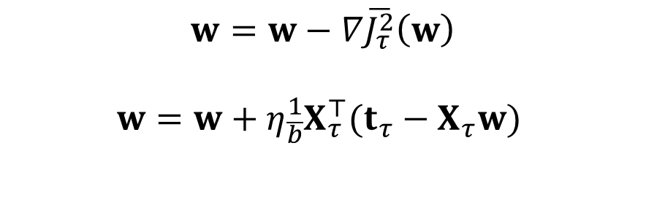
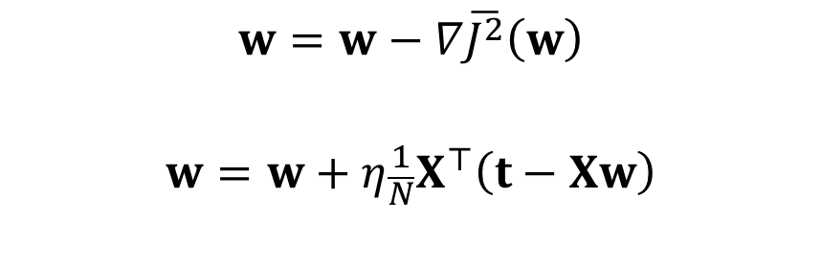
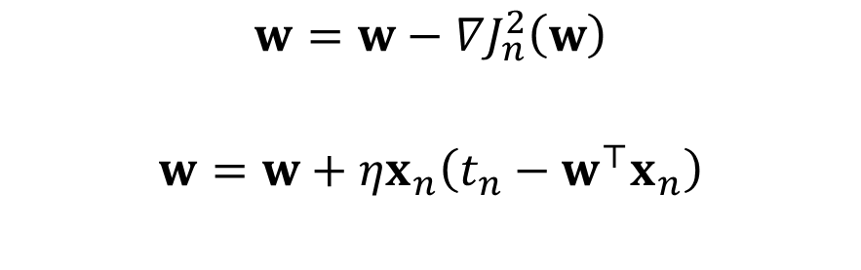
Batch vs Mini-Batch Gradient Decent
Batch Gradient Descent
Stochastic Gradient Descent
$$w=w−∇\overline{J^{2}}\left(w\right)$$
$$w=w+η\frac{1}{N}X^{⊤}\left(t−Xw\right)$$
$$w=w−∇J_{n}^{2}\left(w\right)$$
$$w=w+ηx_{n}\left(t_{n}−w^{⊤}x_{n}\right)$$
Mini-Batch Gradient Descent
✔
GD
Mini-batch GD
x
SGD
$$w=w−∇\overline{J_{τ}^{2}}\left(w\right)$$
$$w=w+η\frac{1}{b}X_{τ}^{⊤}(t_{τ}−X_{τ}w)$$
x
x
x
x
x
x
x
x
x
x
x
x
x
x
x
x
x
x
x
x
x
x
x
x
x
x
x
LS

Slide 56
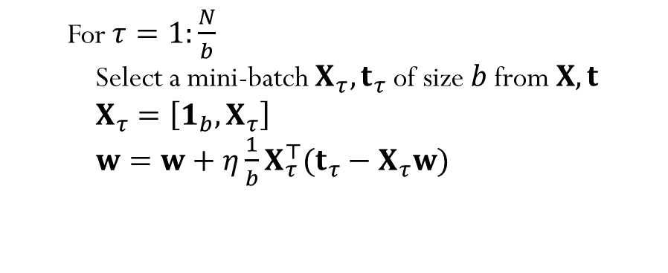
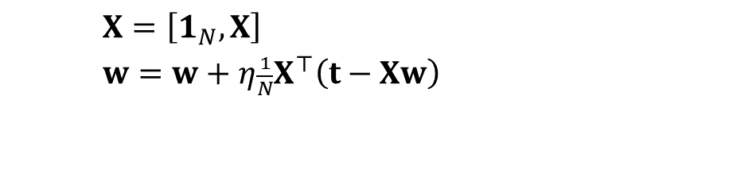

Mini-Batch SGD and Batch Updates GD
Batch Gradient Descent on LR
Stochastic Gradient Decent on LR
$X=\left[1_{N},X\right]$
$w=w+η\frac{1}{N}X^{⊤}\left(t−Xw\right)$
For $n=1:N$
$x_{n}={\left[1,x_{n}^{⊤}\right]}^{⊤}$
$w=w+η\frac{1}{N}x_{n}(t_{n}−w^{⊤}x_{n})$
Mini-Batch Gradient Descent on LR
✔
For $τ=1:\frac{N}{b}$
Select a mini-batch $X_{τ},t_{τ}$ of size $b$ from $X,t$
$X_{τ}=\left[1_{b},X_{τ}\right]$
$w=w+η\frac{1}{b}X_{τ}^{⊤}(t_{τ}−X_{τ}w)$

Slide 57



Mini-Batch SGD and Batch GD Algorithms (with Epochs)
Batch Gradient Descent on LR
Stochastic Gradient Decent on LR
Initialise $w$ and $η=η_{0}$
For epoch $= 1:epcs$
$X=\left[1_{N},X\right]$
$w=w+η\frac{1}{N}X^{⊤}\left(t−Xw\right)$
Decay $η$
Return $w$
Initialise $w$ and $η=η_{0}$
For epoch $= 1:epcs$
For $n=1:N$
$x_{n}={\left[1,x_{n}^{⊤}\right]}^{⊤}$
$w=w+η\frac{1}{N}x_{n}(t_{n}−w^{⊤}x_{n})$
Decay $η$
Return $w$
Mini-Batch Gradient Descent on LR
✔
Initialise $w$ and $η=η_{0}$
For epoch $= 1:\text{epoch}\text{s}$
For $τ=1:\frac{N}{b}$
Select a mini-batch $X_{τ},t_{τ}$ of size $b$ from $X,t$
$X_{τ}=\left[1_{b},X_{τ}\right]$
$w=w+η\frac{1}{b}X_{τ}^{⊤}(t_{τ}−X_{τ}w)$
Decay $η$
Return $w$

Slide 58
Summary
We covered the essential ideas of
Regression analysis
Loss function
Exact and Approximate learning algorithms for the linear regression
Least Squares
Gradient Descent
Stochastic Gradient Descent

